Slide 1
// LEADERSHIP BUSINESS CASE
hireDiverse
The Business Case for hireDiverse
Expand diverse talent reach, reduce recruitment admin, and document measurable employment equity outreach.
hireDiverse · Audience Insights

Slide 2
// EXECUTIVE RECOMMENDATION
Approve a 12-month HireDiverse employment equity outreach partnership — $7,000/year.
We pull jobs from your careers site, promote them to diverse talent through the hireDiverse network, and provide reporting HR can use to demonstrate outreach activity and employment-equity compliance.
INVESTMENT
$7,000
01
YEAR-ROUND REACH
/ YEAR
Ongoing recruitment promotion and employer branding across the hireDiverse network.
Employment Equity
Outreach
02
QUARTERLY EVIDENCE
Recruitment reporting and candidate engagement metrics leadership can review.
Decision requested
Approve the annual plan and authorize launch.
03
ANNUAL DOCUMENTATION
An Employment Equity Outreach Report that consolidates activity and results.
hireDiverse · Audience Insights

Slide 3
// WHY NOW
Employment equity is stronger when it can be demonstrated — not just stated.
For employers subject to federal employment equity requirements, outreach needs to be systematic, measurable and documented. For other organizations, the same approach provides credible evidence that diversity commitments are translating into action.
$1M+
100+
1 YEAR
FCP CONTRACT THRESHOLD
EMPLOYEES IN CANADA
TO FIRST COMPLIANCE ASSESSMENT
COMPLIANCE REQUIRES EVIDENCE OF ACTION
Workforce information. Representation analysis. Numerical goals. Reasonable progress.
Current federal reporting continues to cover women, Indigenous peoples, persons with disabilities and members of visible minorities; modernization of the Employment Equity Act remains underway.
Source: Government of Canada — Federal Contractors Program; ESDC 2026–27 Departmental Plan.
hireDiverse · Audience Insights

Slide 4
// AUDIENCE INSIGHTS
Meet the hireDiverse Audience
Reach diverse, equity-deserving and underrepresented job seekers across Canada — with visibility into how they engage with your opportunities.
300,000+
60,000+
1.8M
66%
MONTHLY PAGE VIEWS
UNIQUE JOB SEEKERS WEEKLY
JOB IMPRESSIONS PER QUARTER
MID-SENIOR PROFESSIONAL
hireDiverse · Audience Insights
Source: available candidate profile and platform engagement data.

Slide 5
// WHO EMPLOYERS REACH
One platform. Broader employment equity reach.
hireDiverse reaches candidates across a wide range of underrepresented and equity-deserving communities — not a single demographic category.
Black and racialized professionals
Indigenous job seekers
Newcomers to Canada
People with disabilities
Women
2SLGBTQIA+ candidates
Older workers
Veterans
Other underrepresented job seekers
hireDiverse · Audience Insights

Slide 6
// AUDIENCE COMPOSITION
A qualified, work-ready talent pool.
93%
69%
26%
Legally eligible to work in Canada
Mid-career or above
Senior or leadership level
38%
29%
23%
Newcomers or immigrants
Visible minorities
Black job seekers
hireDiverse · Audience Insights
Source: available candidate profile and platform engagement data.

Slide 7
// WHO'S ENGAGING
A working-age, Canada-wide audience.
AGE
AVAILABLE GENDER DATA
Ages 18–24
33%
52%
Male
Ages 25–44
40%
48%
Ages 45–64
27%
Female
Over 66% have 5+ years of work experience — a working-age audience spanning early-career to seasoned professionals.
hireDiverse · Audience Insights
Source: available candidate profile and platform engagement data.

Slide 8
// GEOGRAPHIC REPRESENTATION
Reach spans every major Canadian labour market.
Weighted toward Ontario and Quebec, with meaningful reach across every region.
Ontario
38%
Quebec
24%
British Columbia
15%
Alberta
14%
Atlantic Canada
9%
hireDiverse · Audience Insights
Source: available candidate profile and platform engagement data.

Slide 9
// WHO OUR CANDIDATES ARE
The professions behind the audience.
Working professionals across every major job function — weighted toward technology, engineering and client-facing roles.
Technology & Engineering
30%
Customer Service, Sales & Hospitality
20%
Administration, HR & Project Management
15%
Education, Healthcare & Community Services
13%
Marketing, Communications & Creative
10%
Finance, Legal & Compliance
4%
Operations, Supply Chain & Logistics
3%
Other
5%
hireDiverse · Audience Insights
Source: available candidate profile and platform engagement data.

Slide 10
// HOW WE REACH CANDIDATES
More than one traffic source.
hireDiverse combines community reach with direct reach and traffic, so your job opportunities reach candidates through more than a single channel.
01
02
03
04
hireDiverse Brand Recognition
Community-Based Partner Network
Candidate Email Communications
Search Engines & External Distribution
Candidates search and discover opportunities directly on the hireDiverse job board.
Jobs are shared through organizations working directly with diverse and job seekers.
Roles are delivered to engaged subscribers through targeted email distribution.
Jobs reach additional candidates through search engines and external recruitment channels.
hireDiverse · Audience Insights

Slide 11
// WHAT EMPLOYERS CAN MEASURE
Reach is useful.
Knowing what happened next is better.
Job views
Apply clicks
Click-through rate
Company page engagement
Job-by-job performance
Outreach reporting
hireDiverse gives employers visibility into recruitment performance — so you can understand what's generating interest, identify underperforming roles, and improve your approach over time.
hireDiverse · Audience Insights

Slide 12
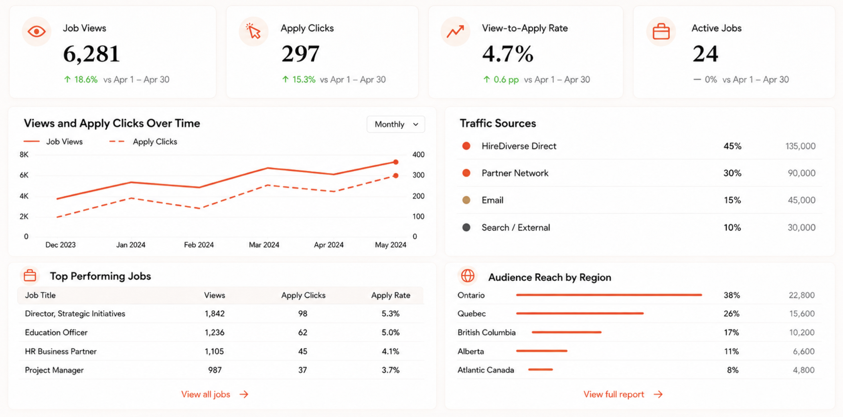
// REAL EMPLOYER RESULTS
What measurable recruitment looks like.
An anonymized employer example showing the kind of performance visibility hireDiverse provides.
hireDiverse · Audience Insights

Slide 13
// WHY hireDiverse
A generic job post is distribution.
hireDiverse adds evidence of inclusion.
The difference is not simply where the job appears — it is the audience, channels and reporting around it.
WHAT HR NEEDS
TYPICAL BROAD-MARKET JOB BOARD
hireDiverse
AUDIENCE
Broad, general-market candidate reach
Equity-deserving and underrepresented job seekers across Canada
DISTRIBUTION
Primarily job-board and standard search/alert channels
Job board + community partners + candidate email + external distribution
MEASUREMENT
Standard posting metrics; depth varies by provider
Job views, apply clicks, CTR, company-page engagement and job-by-job performance
EQUITY CASE
Not purpose-built for employment equity documentation
Quarterly reporting + annual Employment Equity Outreach Report
Feature availability varies by provider. Comparison reflects the hireDiverse annual Employment Equity Outreach offer versus a typical broad-market posting model.
hireDiverse · Audience Insights

Slide 14
// ANNUAL OUTREACH PLAN
One annual outreach plan.
No manual job posting required.
hireDiverse pulls jobs from your careers page, promotes them to an equity-deserving audience across Canada, and reports on what happened.
Turn Audience Insights Into Inclusion
Employment Equity Outreach
$7,000
REACH
/ year
Show that jobs are being promoted beyond general-market channels.
EVIDENCE
Jobs pulled from your careers page
Track views, apply clicks, engagement and job-by-job performance.
Year-round visibility on hireDiverse
DOCUMENTATION
Candidate email and partner distribution
Use quarterly reporting and an annual outreach summary in leadership conversations.
Best fit: HR teams that need credible outreach, stronger candidate reach, and measurable activity without adding admin work.
hireDiverse · Audience Insights

Slide 15
// NEXT STEPS
hireDiverse
Next steps
If the plan is approved, launch is straightforward: connect the job source, publish active roles, and review performance quarterly.
Typical time from approval to launch: 5 business days.
01
Approve the Employment-Equity Outreach Plan
03
Launch active jobs on hireDiverse
Confirm the 12-month $7,000 partnership and launch timing.
Roles are published and promoted to the hireDiverse audience and distribution network.
02
Share the careers-page source
04
Review outreach performance
hireDiverse uses the organization’s existing job source so your team is not manually reposting roles.
Quarterly updates and an annual summary give HR evidence of reach and engagement.
Ready to move forward?
Shauna Cole
hireDiverse
shauna@hireDiverse.ca
hireDiverse · Audience Insights

